Slide 1
Health Symptom Checker
IBM SkillsBuild Internship on AI & Cloud
Presented By:
1. Kirti vardhan singh-Centurion university of Technology and Management-Computer Science

Slide 2
OUTLINE
Problem Statement (Should not include solution)
Proposed System/Solution
System Development Approach (Technology Used)
Algorithm & Deployment
Result (Output Image)
Conclusion
Future Scope
References

Slide 3
Problem Statement
Agentic AI Health Symptom Checker The Challenge – An Agentic AI Health Symptom Checker helps users understand their health conditions by analyzing symptoms and providing probable causes, preventive advice, and care recommendations. It retrieves verified medical data, symptom databases, and guidelines from trusted sources like WHO, government health portals, and medical journals. Users can input symptoms in natural language such as “I have a sore throat and fever,” and the agent provides possible conditions, urgency level, home remedies, and when to consult a doctor. It supports multi-language interaction and avoids self-diagnosis risks by offering educational and referral-based suggestions. This AI-driven assistant promotes early detection, reduces misinformation, and empowers users to take informed health actions.

Slide 4
Proposed Solution
The proposed solution is a conversational AI, the "Health Symptom Checker," designed to act as a first point of contact for health queries.
It uses Natural Language Processing to understand symptoms and provide pre-defined advice from a dedicated knowledge base.
A key feature is the ability to escalate the conversation to a live human agent when requested.
The final AI agent is designed for easy deployment and integration into any webpage via a simple code snippet.

Slide 5
System Approach
Conversational AI Platform: IBM Watson Assistant is used to build the chatbot, understand natural language, and manage the dialogue flow.
Backend Logic: A custom backend API was developed using Python and the Flask framework to search for and retrieve relevant health advice.
Hosting: The backend API is deployed on the Render.com cloud platform.
Live Agent Handoff: Twilio's platform (specifically WhatsApp Sandbox and Flex) is integrated to manage the escalation to human agents.

Slide 6
Algorithm & Deployment
Algorithm: The system uses a "search and retrieve" model rather than a predictive one.
Intent Recognition: IBM Watson Assistant processes the user's message to identify the key symptom or intent (e.g., "headache," "contact agent").
API Call: The corresponding "Action" in Watson triggers an API call to the Flask backend.
Data Retrieval: The Flask API searches a structured JSON file (knowledge base) for the symptom and retrieves the associated advice.
Response & Escalation: The advice is sent back to the user. If the "contact agent" intent is triggered, a signal is sent to Twilio to initiate the handoff.
Deployment: This is a multi-platform cloud deployment. The AI assistant runs on IBM Cloud, the backend on Render, and the communication channel on Twilio.

Slide 7
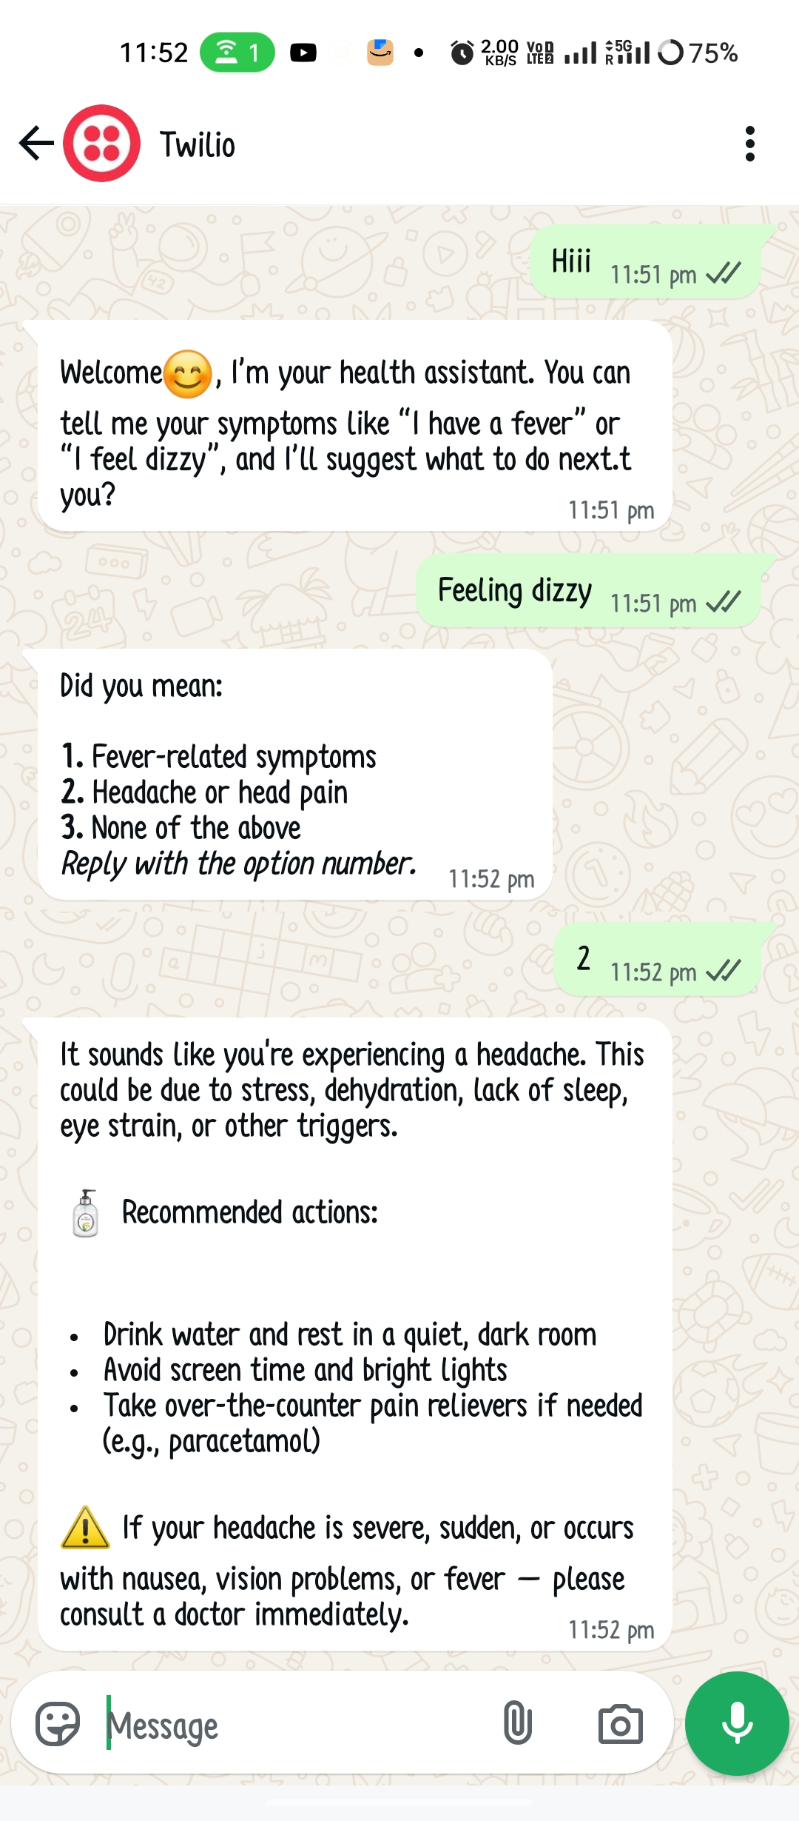
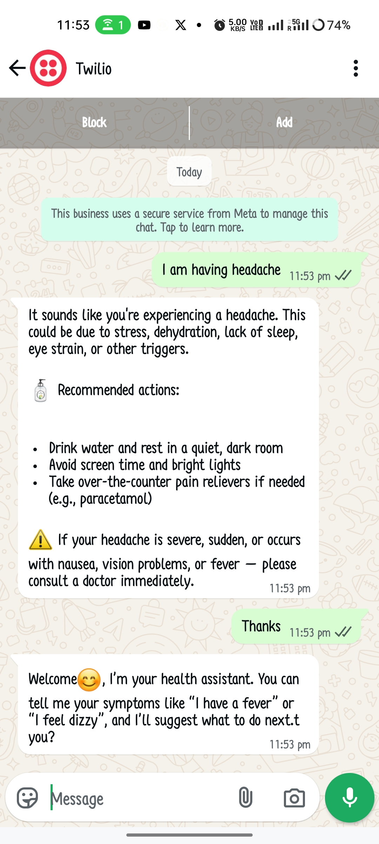
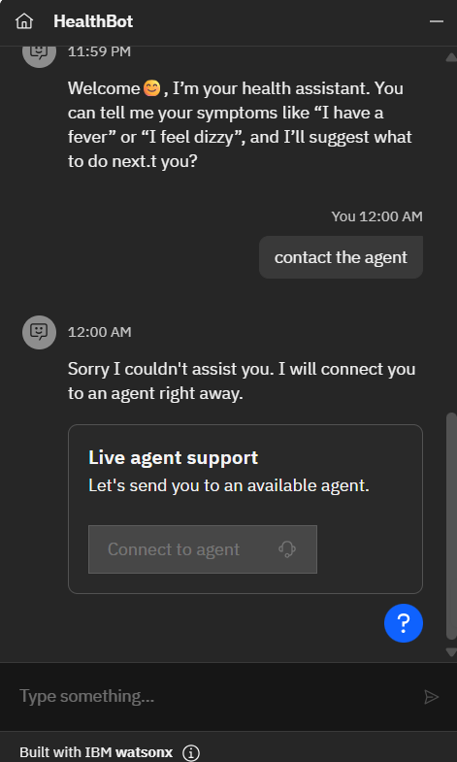
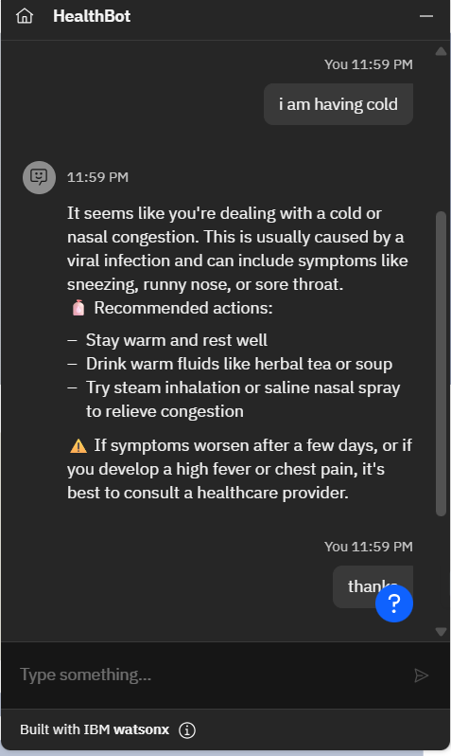
Result

Slide 8
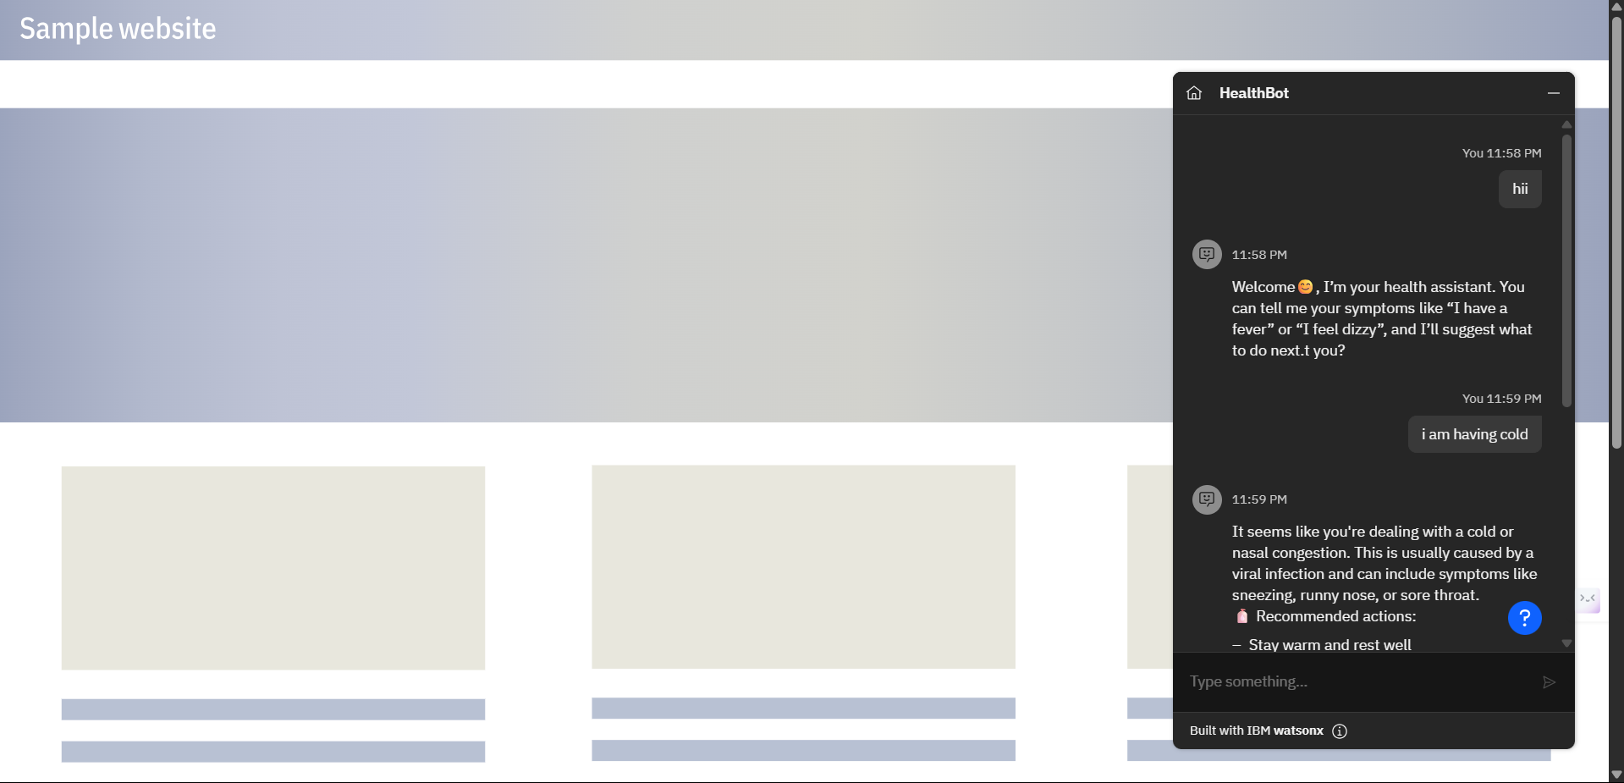
Result

Slide 9
Conclusion
The project successfully created a functional, modular, and scalable Health Symptom Checker using modern AI and cloud technologies.
It demonstrates the power of combining a sophisticated AI assistant like Watson with custom backend logic to create a practical, real-world application.
The system provides a valuable service by offering accessible, first-level health guidance and a clear path for escalation.

Slide 10
Future scope
Expand Knowledge Base: Integrate with a dynamic medical API to provide more extensive and up-to-date information.
Personalization: Add user session management and history tracking to provide more personalized advice over time.
Multi-language Support: Extend the assistant's capabilities to understand and respond in multiple languages.
Advanced Analytics: Implement analytics to track common symptoms and user queries to identify health trends.

Slide 11
References
document360.com - How to Create Project Documentation with Examples & ...
googleusercontent.com - IBM Skills Build Free Internship || AI & Cloud || Free Internship ...
slideshare.net - IBM Watson assistant | PPTX
projectmanager.com - 20 Essential Project Documents
brightwork.com - A Quick Guide to 9 Essential Project Documents
geeksforgeeks.org - How to Create Project Documentation with Examples?

Slide 12
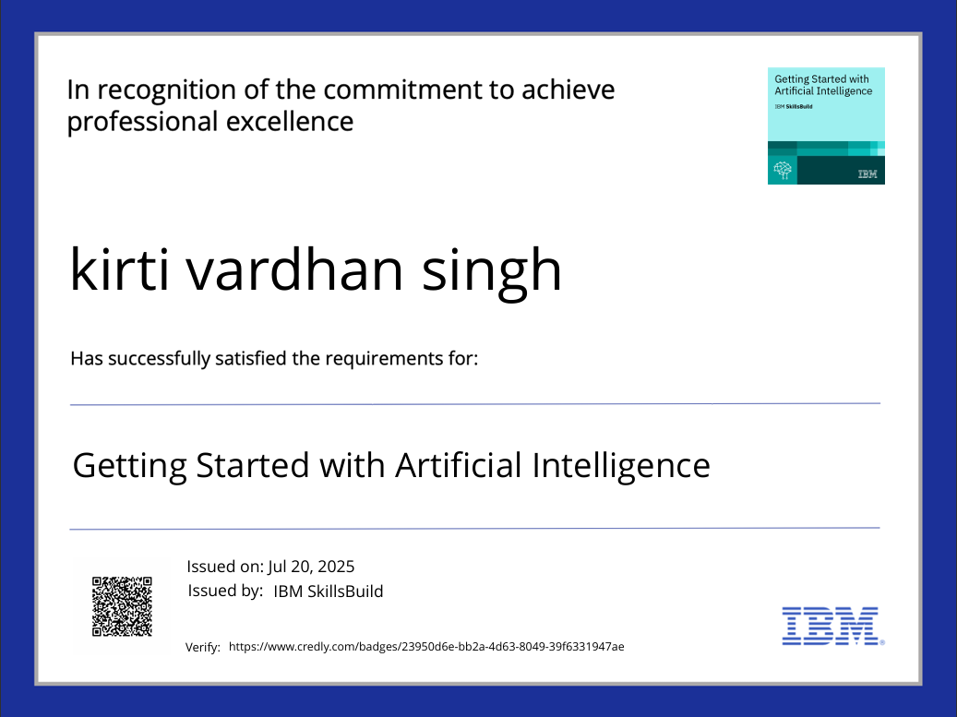
IBM Certifications

Slide 13
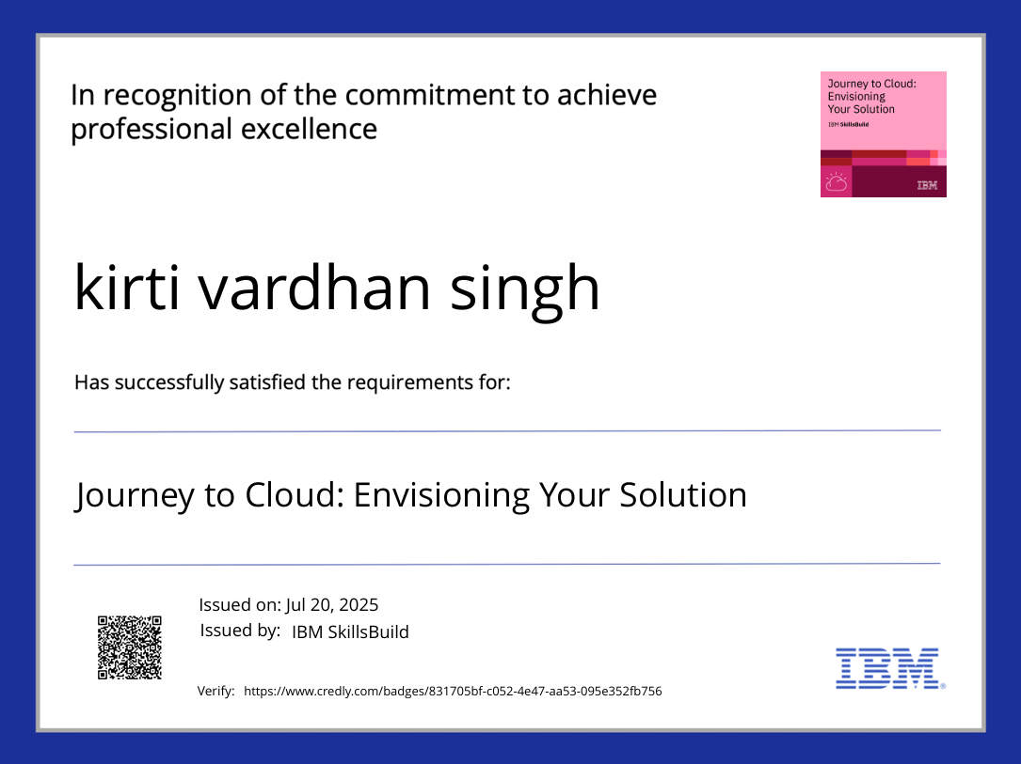
IBM Certifications

Slide 14
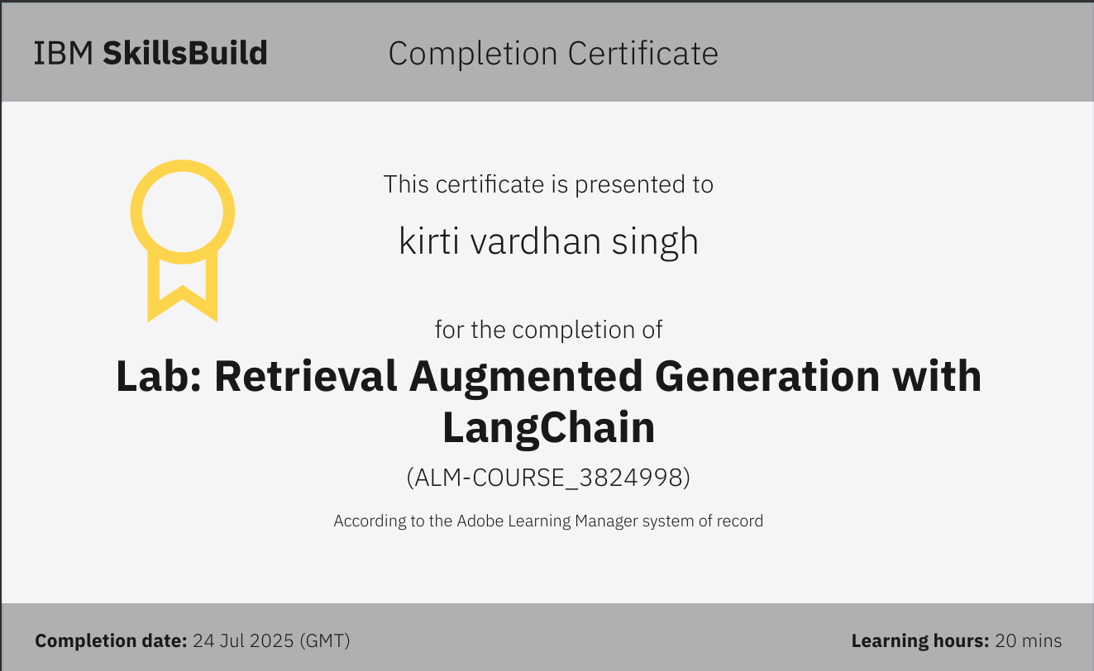
IBM Certifications

Slide 15
THANK YOU

